Slide 1
Interprocess Communication

Slide 2
Interprocess Communication
A process has access to the memory which constitutes its own address space
So far, we have discussed communication mechanisms only during process creation/termination
When a child process is created, the only way to communicate between a parent and a child process is:
– The parent receives the exit status of the child
Processes may need to communicate during their life time

Slide 3
Interprocess Communication
Processes within a system may be independent or cooperating
Cooperating process can affect or be affected by other processes
Reasons for processes corporation
Information sharing
Computation speedup
Modularity
Convenience
Cooperating processes need interprocess communication (IPC)
Two fundamental models of IPC
Shared memory
Message passing

Slide 4
Communication Models
Shared memory
Need to establish a region of shared memory
Usually resides in the address space of a process
OS system calls are only needed to setup the memory
Basic operations: read/write
Message passing
Send messages between processes
Requires system calls to the OS for every message
Often easier to realize for networked process communication
Basic operations: send/receive

Slide 5
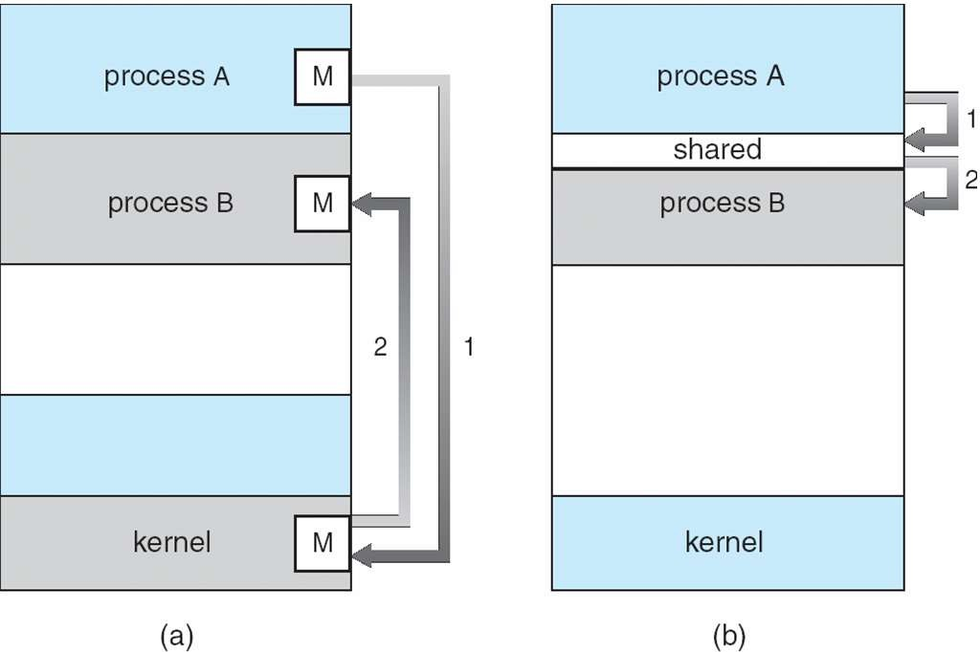
Communication Models

Slide 6
Shared Memory
Usually resides in the address space of the process creating shared memory
Require processes to coordinate their processing
Results of read/write not guaranteed to be deterministic
Concurrent writes to the same address
Result depends on the order of operations
P
Q
Read/Write Address
Shared Memory

Slide 7
Shared Memory – POSIX API
Process first creates shared memory segment
id = shmget(IPC_PRIVATE, size, S_IRUSR | S_IWUSR);
Process wanting access to that shared memory must attach to it
shared_memory = (char *) shmat(id, NULL, 0);
Now the process could write to the shared memory
sprintf(shared_memory, "Writing to shared memory");
When done a process can detach the shared memory from its address space
shmdt(shared_memory);

Slide 8
Example: Sender
#include <stdio.h>
#include <stdlib.h>
#include <string.h>
#include <sys/ipc.h>
#include <sys/shm.h>
#include <sys/stat.h> // Include for S_IRUSR and S_IWUSR constants
#define SHM_SIZE 1024 // Size of the shared memory segment
int main() {
int shmid;
key_t key = 1234; // Unique key for shared memory segment
char *shm_ptr;
// Create a shared memory segment or obtain the identifier if it already exists
if ((shmid = shmget(key, SHM_SIZE, IPC_CREAT | S_IRUSR | S_IWUSR)) == -1) {
perror("shmget");
exit(EXIT_FAILURE);
}
Notes:
The shmat() function attaches the shared memory segment associated with the shared memory identifier, shmid, to the address space of the calling process. The segment is attached at the address specified by one of the following criteria:If shmaddr is a NULL pointer, the segment is attached at the first available address as selected by the system.
If shmaddr is not a NULL pointer, and the flag, SHM_RND was specified, the segment is attached at the address given by (shmaddr-((prtdiff_t)shmaddr%SHMLBA)) where % is the 'C' language remainder operator.
If shmaddr is not a NULL pointer, and the flag, SHM_RND was not specified, the segment is attached at the address given by shmaddr.
The segment is attached for reading if the flag, SHM_RDONLY, is specified with shmflg and the calling process has read permission. If the flag is not set and the process has both read and write permission, the segment is attached for reading and writing.The first attach of newly created __IPC_MEGA segment, as well as subsequent attaches, will have write access to the segment, regardless of the SHM_RDONLY option.
All attaches to an __IPC_MEGA shared memory segment have the same Write or Read access authority. If a segment is enabled for writes then all attaches have the ability to read and write to the segment. If the segment is disabled for writes, then all attaches have the ability to read from the segment and cannot write to the segmentThe first attach of newly created __IPC_MEGA segment, as well as subsequent attaches, will have write access to the segment, regardless of the SHM_RDONLY option. Write/Read access can be changed by the shmctl() function, Shared Memory Control Operations.
An __IPC_MEGA shared memory segment is attached as follows:If shmaddr is zero and __IPC_MEGA segment, then the segment will be attached at the first available address selected by the system on a segment boundary.
If shmaddr is not zero and SHM_RND is specified and __IPC_MEGA segment, the segment address will be truncated to the segment boundary (last 20 bits zero).
If shmaddr is not zero and SHM_RND is not specified and __IPC_MEGA segment, the segment address must be a megabyte multiple (segment boundary).
Returned value
If successful, shmat() increments the value of shm_nattach in the data structure associated with the shared memory ID of the attached shared memory segment and returns the segment's starting address.
If unsuccessful, shmat() returns -1 and sets errno to one of the following values:Error CodeDescriptionEACCESOperation permission is denied to the calling process.EINVALThe value of shmid is not a valid shared memory identifier; the shmaddr is not a NULL pointer and the value of (shmaddr-((ptrdiff_t)shmaddr%SHMLBA)) is an illegal address for attaching shared memory segments; or the shmaddr is not a NULL pointer, SHM_RND was specified, and the value of shmaddr is an illegal address for attaching shared memory segments.The shared memory address, *shmaddr, is not zero, is not on a megabyte boundary, and SHM_RND was not specified.
EMFILEThe number of shared memory segments attached to the calling process would exceed the system-imposed limit.ENOMEMThe available data space is not large enough to accommodate the shared memory segment.

Slide 9
Sender
// Attach the shared memory segment to the sender's address space
shm_ptr = shmat(shmid, NULL, 0);
if (shm_ptr == (char *)(-1)) {
perror("shmat");
exit(EXIT_FAILURE);
}
// Write data to the shared memory
strcpy(shm_ptr, "Hello, Receiver!");
// Detach the shared memory segment
shmdt(shm_ptr);
return 0;
}

Slide 10
Example:Reciver
#include <stdio.h>
#include <stdlib.h>
#include <string.h>
#include <sys/ipc.h>
#include <sys/shm.h>
#include <sys/stat.h> // Include for S_IRUSR and S_IWUSR constants
#define SHM_SIZE 1024 // Size of the shared memory segment
int main() {
int shmid;
key_t key = 1234; // Same key as the sender
char *shm_ptr;
// Locate the existing shared memory segment
if ((shmid = shmget(key, SHM_SIZE, S_IRUSR | S_IWUSR)) == -1) {
perror("shmget");
exit(EXIT_FAILURE);
}

Slide 11
Reciver
// Attach the shared memory segment to the receiver's address space
shm_ptr = shmat(shmid, NULL, 0);
if (shm_ptr == (char *)(-1)) {
perror("shmat");
exit(EXIT_FAILURE);
}
// Read data from the shared memory
printf("Received message: %s\n", shm_ptr);
// Detach the shared memory segment
shmdt(shm_ptr);
// Mark the shared memory segment for removal (optional)
shmctl(shmid, IPC_RMID, NULL);
return 0;
}

Slide 12
Message Passing
No sharing of resources between processes needed
Basic operations
send({destination}, message): send a message
receive({source}, message): receive a message
If P and Q wish to communicate, they need to:
Establish a communication link between them
Exchange messages via send/receive
Implementation of communication link
Physical (e.g., shared memory, hardware bus)
Logical (e.g., logical properties)
Notes:
You need to address the low-level details of data transfer (physical link) and provide a higher-level, well-defined mechanism for processes to communicate meaningfully (logical link). This holistic approach ensures effective and reliable communication between processes in an application or system.

Slide 13
Implementation Questions
How are links established?
Can a link be associated with more than two processes?
How many links can there be between every pair of communicating processes?
What is the capacity of a link?
Is the size of a message that the link can accommodate fixed or variable?
Is a link unidirectional or bi-directional?

Slide 14
Direct Communication
Direct symmetric communication
Each process that wants to communicate must name the recipient
send(P, message)
Send a message to process P
receive(Q, message)
Receive a message from process Q
Communication link established automatically
Link associated exactly between two processes
Direct asymmetric communication
Use instead
send(P, message)
Send a message to process P
receive(message)
Receive message from arbitrary process

Slide 15
Indirect Communication
Problem of Direct Addressing
Changing a process identifier may impact all other process definitions
Limited modularity
Indirect addressing uses mailbox or port concept
Mailbox: Shared by multiple receiver
Port: Receiver Specific, e.g., WebServer uses port 80
send(A, message)
Send a message to mailbox/port named A
receive(A, message)
Receive a message from mailbox A
Link is only established if both members share a mailbox
A link may be associated with more than 2 processes
Each pair of processes may share several communication links

Slide 16

One-to-One
Private communication link between two processes
Mailbox

Slide 17
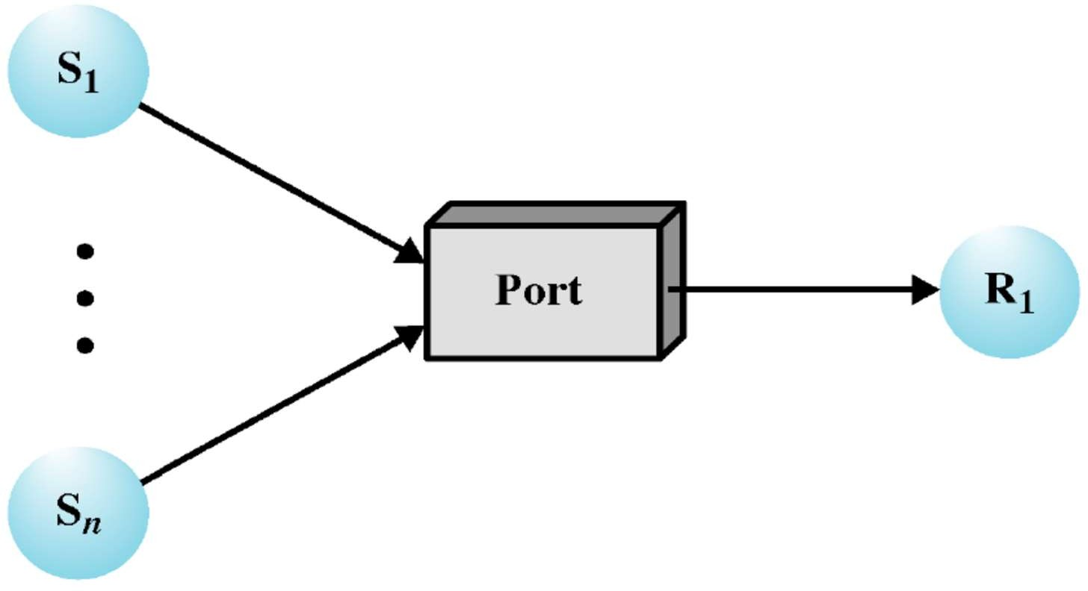
Many-to-One
Client/server interactions
Mailbox

Slide 18
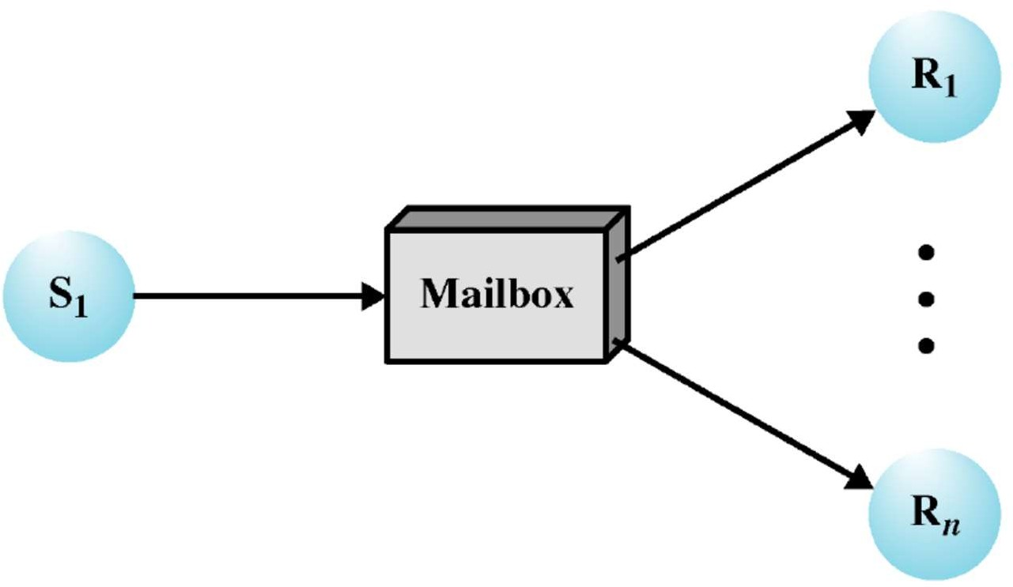
One-to-Many
Multicast information from a source to a set of receivers

Slide 19
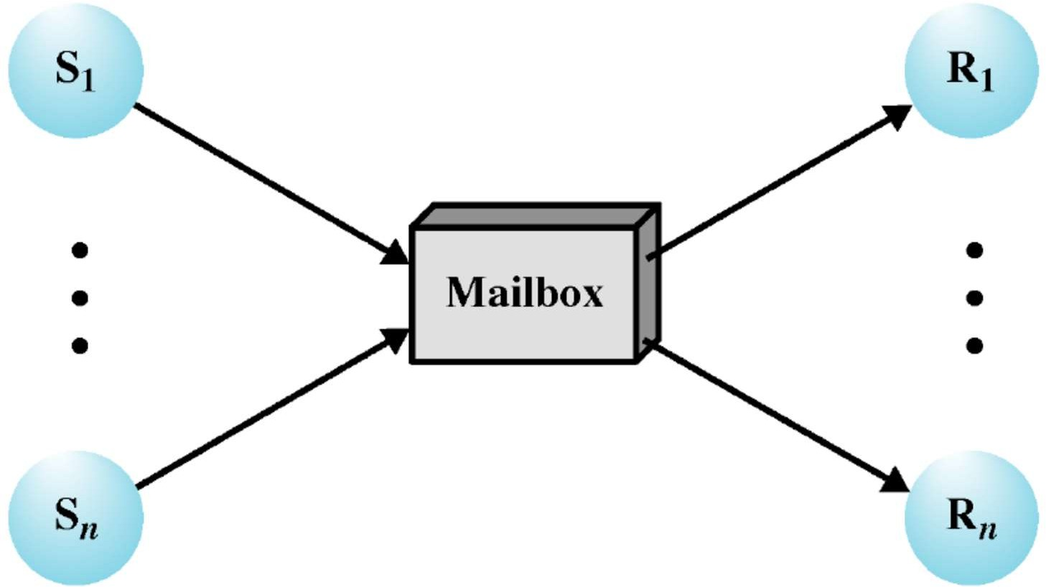
Many-to-Many
Allows for many-to-many communication

Slide 20
Indirect Communication – Example
Mailbox sharing
P1, P2, and P3 share mailbox A
P1, sends; P2 and P3 receive
Who gets the message?
Possible solutions
Allow a link to be associated with at most two processes
Allow only one process at a time to execute a receive operation
Allow the system to select arbitrarily the receiver
Sender is notified of the receiver

Slide 21
Indirect Communication – Ownership
Could be either process or Operating System
Case process is the owner of a mailbox
Owner performs as the receiver of messages
User sends messages to the mailbox
Mailbox destroyed with termination of the process
Case OS is the owner
Need support for processes to
Create
Send and receive messages through the mailbox
Delete a mailbox
Manage ownership
Possibly multiple owners/ receivers

Slide 22
Indirect Communication – Ownership
Process owns (i.e. mailbox is implemented in user space)
Only the owner may receive messages through this mailbox
Other processes may only send
When process terminates any “owned” mailboxes are destroyed
Kernel owns
Kernel provides mechanisms to create, delete, send and receive through mailboxes
Mailbox has existence of its own independent of any process
Process that creates mailbox owns it (and so may receive through it)
Process may transfer ownership to another process

Slide 23
Synchronization
Message passing may be either blocking or non-blocking
Blocking is considered synchronous
Blocking send has the sender block until the message is received
Blocking receive has the receiver block until a message is available
Non-blocking is considered asynchronous
Non-blocking send has the sender send the message and continue
Non-blocking receive has the receiver receive a valid message or null
Combinations of blocking and non blocking calls
Blocking send + blocking receive
Tight coupling between processes
Non blocking send + blocking receive

Slide 24
Buffering
All messaging system require framework to temporarily buffer messages (i.e., Queues)
Zero capacity
No messages may be queued within the link
Requires sender to block until receiver retrieves message
Bounded capacity
Link has finite buffer capacity to hold messages
If link is full then sender must block until one is freed up
Unbounded capacity
Link has unlimited buffer space
Send never needs to block

Slide 25
IPC Case Study: Unix Pipes

Slide 26
Process Creation Recap
Consider the following code
for(int i = 0; i < 4; i++){ fork();
}
How many process would be created?
Represent the processes in form of tree

Slide 27
Unix IPC
Shared memory
Process
Process
Process
Process
Process
Process
Shared info
Kernel
filesystem

Slide 28
File Descriptors
PCB of each process keeps track of open files
Pointer to file_struct, a kernel-resident array data structure containing the details of open files
PCB
file_struct
files
…
file
f_mode
fd[1]
fd[2]
…
f_pos
f_inode
fd[255]
f_op
…
…
File operation routines

Slide 29
File Descriptors
files_struct contains pointers to file data structures
– Each one describes a file being used by this process
f_mode: Describes file mode, read only, read and write or write only
f_pos: Holds the position in the file where the next read or write operation will occur
f_inode: Points at the actual file
file_struct
…
file
f_mode
PCB
files
fd[1]
f_pos
fd[2]
f_inode
…
f_op
…
fd[255]
…
File operation routines
68

Slide 30
File Descriptors
When a process opens a file, one of the free file pointers in the
files_struct is used to point to the new file structure
When Unix processes do any sort of I/O, they do it by reading or writing to a file descriptor
– A file descriptor is simply an integer associated with an open file
All accesses to files are via standard system calls which pass or return file descriptors
file_struct
…
file
f_mode
PCB
files
fd[1]
f_pos
fd[2]
f_inode
…
f_op
…
fd[255]
…
File operation routines
30

Slide 31
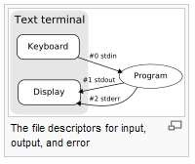
Standard Input, Output, Error
Linux processes expect three file descriptors to be open when they start
Standard input: File descriptor 0 (stdin)
Standard output: File descriptor 1 (stdout)
Standard error: File descriptor 2 (stderror)
These three are usually inherited from the creating parent process
31

Slide 32
Standard Input, Output, Error: Example
Read from standard input (by default it is keyboard)
char buffer[10];
read(0,buffer,5);
Write to standard output (by default is is monitor))
char buffer[10];
write(1,buffer,5);
By changing the file descriptors we can write to files
fread/fwrite etc. are wrappers around the above read/write
functions
32

Slide 33
Unix Fact
Everything in Unix is a file
A file in Unix can be
A network connection
A FIFO queue
A pipe
A terminal
A real on-the-disk file
Or just about anything else
33

Slide 34

Pipes
Pipes represent a channel for Interprocess Communication
Provides a one-way flow of data
Can be thought as a special file that can store a limited amount of data in a first-in-first-out manner, exactly akin to a queue
34
Notes:
Pipes use an internal buffer for temporary data transfer between processes, and this buffer is typically managed by the operating system.
Shared memory involves explicitly creating a region of memory that multiple processes can access directly, and it requires more explicit management by the processes involved.
Difference B/w pips and shared memory:
Pipes are typically used for simple communication between related processes, providing sequential data transfer with automatic synchronization. Shared memory, on the other hand, enables more flexible data exchange between unrelated processes by allowing them to share a common memory region. Shared memory requires manual synchronization and is suitable for scenarios involving multiple processes that need efficient data sharing. The choice between them depends on the nature of communication and process relationships.

Slide 35
Pipes
Shared info in kernel’s memory
Buffer in kernel’s memory
Pfd[1]
Pfd[0]
Pipe
write()
read()
35

Slide 36
Pipes
A pipe is implemented using two file data structures which both point at the same temporary data node
This hides the underlying differences from the generic system calls which read and write to ordinary files
Thus, reading/writing to a pipe is similar to reading/writing to a file
36

Slide 37
Pipes
PCB
file
f_mode
Pipe operation routines
files
file table
…
f_pos
f_inode
f_op
fd[2]
…
fd[3]
…
Pipe
…
file
f_mode
fd[255]
f_pos f_inode
f_op
Buffer not File on Hard disk
…
…
Pipe operation routines
2-Process
76

Slide 38
(Unnamed) Pipe Creation
Two methods for creating (unnamed) pipes
pipe system call
#include <unistd.h>
int pipe(int filedes[2]);
Creates a pair of file descriptors pointing to a pipe inode
Places them in the array pointed to by filedes
filedes[0] is for reading
filedes[1] is for writing
Return value: Success returns zero; error returns -1
popen system call
FILE *popen(const char *command, const char *type); FILE* file = popen("ntpdate", "r");
Opens a process by creating a pipe, forking, and invoking the shell
38
Notes:
popen is a higher-level function for running external commands and managing their input and output streams, whereas the pipe system call is a lower-level mechanism for establishing communication between processes within the same program. The choice between them depends on your specific use case and whether you need to interact with external processes or manage communication between processes in your own program.

Slide 39
Pipe Creation
int main()
{
int pfds[2];
if (pipe(pfds) == -1) {
perror("pipe"); exit(1);
}
}
pfds[0]
pfds[1]
Process Kernel
Pipe
flow of data
39

Slide 40
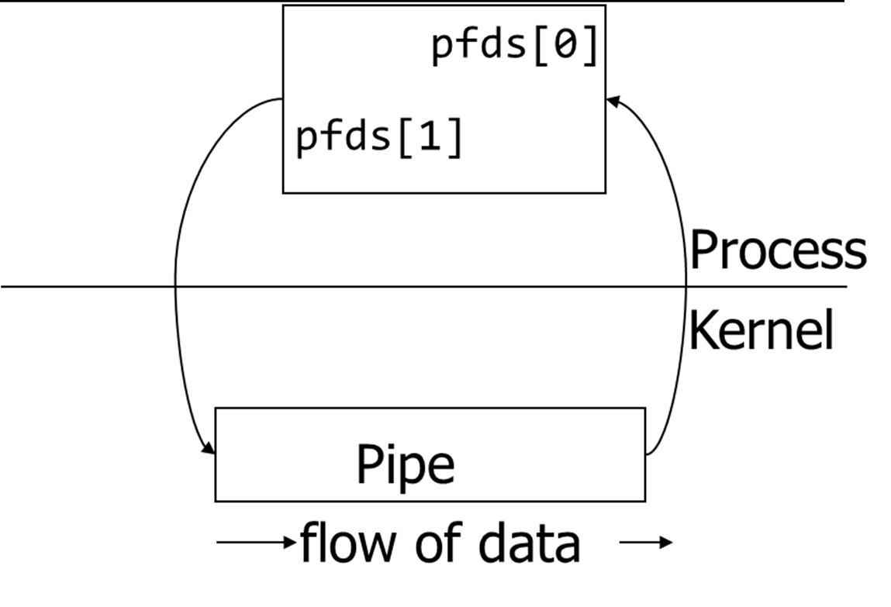
Pipe Example
int main()
{
int pfds[2];
if (pipe(pfds) == -1) {
perror("pipe"); exit(1);
}
printf("writing to file descriptor #%d\n", pfds[1]); write(pfds[1], "test", 5);
printf("reading from file descriptor #%d\n",pfds[0]); read(pfds[0], buf, 5);
printf("read %s\n", buf);
2-Process
}
79

Slide 41
A Channel Between Parent and Child
Child is created by a fork() call executed by the parent
Child process is an image of the parent process
All the file descriptors that are opened by the parent are available in the child
Pipe is inherited by the child
File descriptors refer to the same I/O entity
Pipe may be passed on to the grand-children by the child process or other children by the parent
41

Slide 42
Piping Between Parent and Child
Parent
pfds[0]
Child
pfds[0]
2. fork()
pfds[1]
1. pipe()
pfds[1]
Process
Kernel
Pipe flow of data
42

Slide 43
Piping Between Parent and Child
To allow one way communication each process should close one end of the pipe
Parent Child
2. fork()
4. close(pfds[0]) pfds[0]
pfds[0]
pfds[1] 3. close(pfds[1])
1. pipe()
pfds[1]
Process
Kernel
Pipe flow of data
43

Slide 44
Pipe Closing
The file descriptors associated with a pipe can be closed with the
close(fd) system call
A pipe exists until both file descriptors are closed in all processes
How would we achieve two way communication?
44

Slide 45
Pipe Example
int main() {
int pfds[2]; char buf[30];
pipe(pfds);
if (!fork()) {
close(pfds[0]);
printf(" CHILD: writing to the pipe\n");
write(pfds[1], "test", 5); printf(" CHILD: exiting\n"); exit(0);
}
else {
close(pfds[1]);
printf("PARENT: reading from pipe\n");
read(pfds[0], buf, 5);
printf( "PARENT: read \"%s\"\n", buf); wait(NULL);
}
}
2-Process
84

Slide 46


Full Duplex Communication via Two Pipes
Parent
p1fd[1]
Child
p2fd[1]
p2fd[0]
p1fd[0]
Pipe 1
Pipe 2
46

Slide 47
Named vs. Unnamed Pipes
Unnamed pipe
Unnamed pipes can only be used between related process, such as parent/child, or child/child process
Unnamed pipes can exist only as long as the processes using them
Named pipe
When created, named pipes have a directory entry
Have file access permissions for unrelated processes to use the pipe
Named pipes can be created by using mkfifo system call
int mkfifo(const char *pathname, mode_t mode);
Makes a FIFO special file with name pathname and FIFO's permissions
Any process can open FIFO special file for reading or writing
Opening a FIFO for reading normally blocks until some other process opens the same FIFO for writing, and vice versa
47

Slide 48
Named Pipe Example
Process 1
int main() {
int fd;
char * myfifo = "/tmp/myfifo";
/* create the FIFO(named pipe)*/
mkfifo(myfifo, 0666);
/* write "Hi" to the FIFO */ fd = open(myfifo, O_WRONLY); write(fd, "Hi", sizeof("Hi")); close(fd);
/* remove the FIFO */
unlink(myfifo);
return 0;
}
Process 2
#define MAX_BUF 1024
int main() {
int fd;
char * myfifo = "/tmp/myfifo";
char buf[MAX_BUF];
/* open, read, and display the message from the FIFO */
fd = open(myfifo, O_RDONLY); read(fd, buf, MAX_BUF); printf("Received: %s\n", buf); close(fd);
return 0;
}
48
Notes:
Modes:
S_IRUSR: Read permission for the owner (User).
S_IWUSR: Write permission for the owner (User).
S_IXUSR: Execute permission for the owner (User).
S_IRGRP: Read permission for the group.
S_IWGRP: Write permission for the group.
S_IXGRP: Execute permission for the group.
S_IROTH: Read permission for others (i.e., not the owner or group).
S_IWOTH: Write permission for others.
S_IXOTH: Execute permission for others.
mkfifo("myfifo", S_IRUSR | S_IWUSR | S_IRGRP | S_IWGRP | S_IROTH | S_IWOTH); alternative of 0666

Slide 50

Any Question So Far?
2-Process
91

